Slide 1

POLYTECHNIC OF TURIN
Master’s Degree in Mechanical Engineering
Design of a tubular frame made of natural fiber reinforced composite with epoxy matrix for the cycling industry
Master’s Dissertation
Candidate: Lucrezia Pasi, s288698
Supervisor: Prof. Cristiana Delprete
Co-supervisor: Prof. Chiara Gastaldi
Academic Year 2021-22, 19 October 2022

Slide 2

Aim and content
Design of a bicycle frame made of composite material on Solidworks.
Model the component and its behavior on Hypermesh.
Make a comparison between with natural fiber reinforced composite compared to carbon fiber frame.
Trade-off between sustainability and performance.
Lucrezia Pasi
s288698

Slide 3
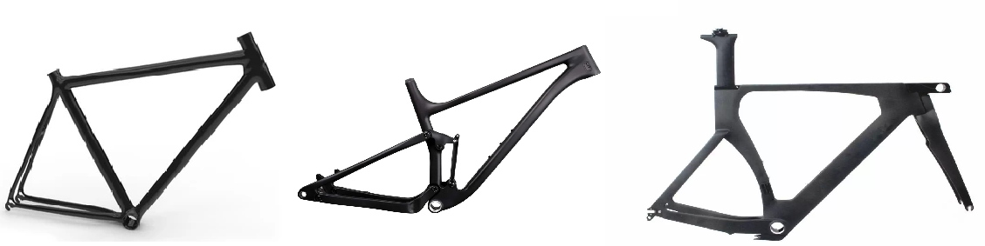
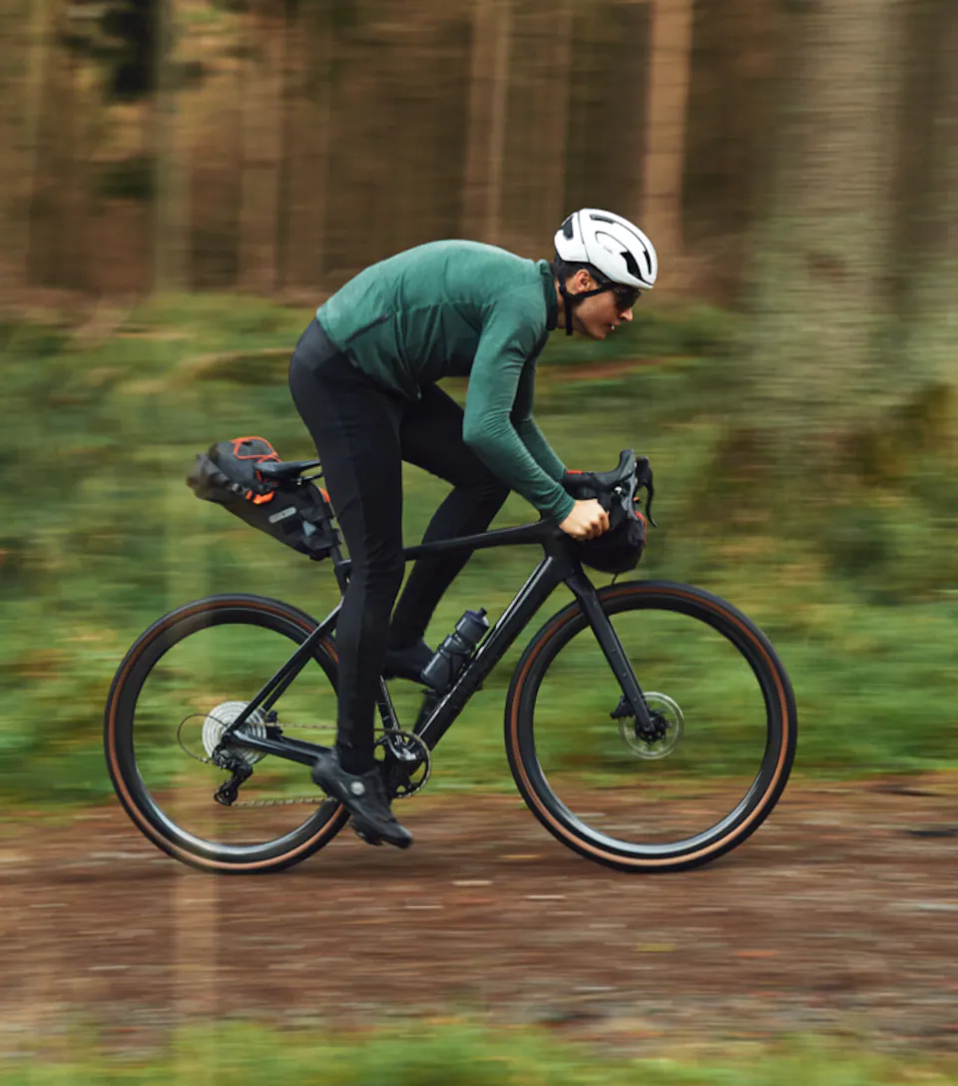
A bicycle frame
Which bicycle and which frame?
A gravel bike
Lucrezia Pasi
s288698

Slide 4
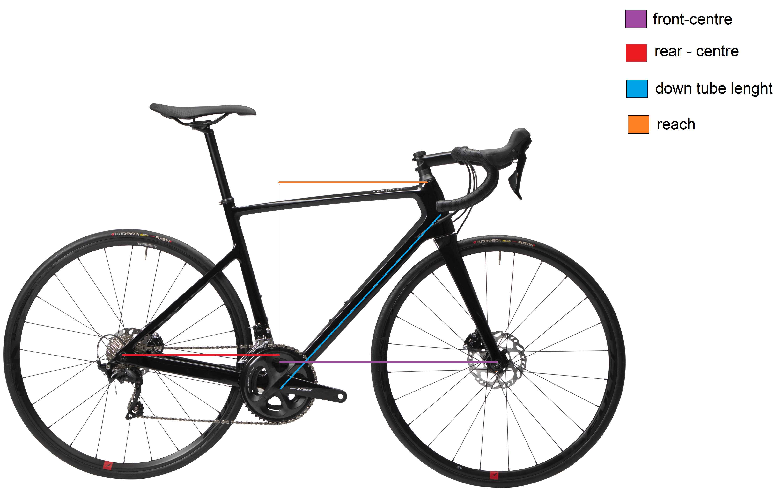
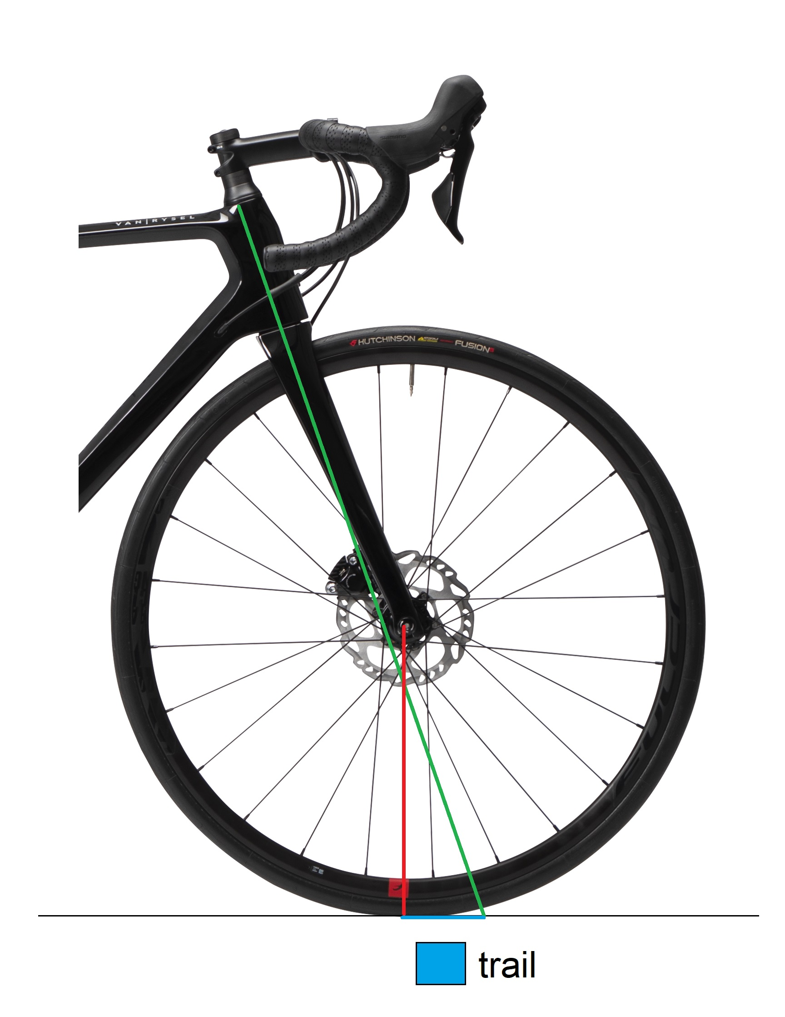
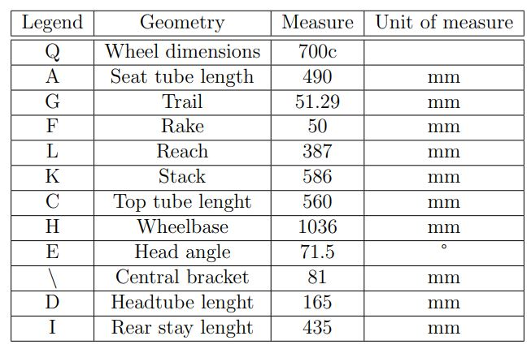
Geometry
Lucrezia Pasi
s288698

Slide 5
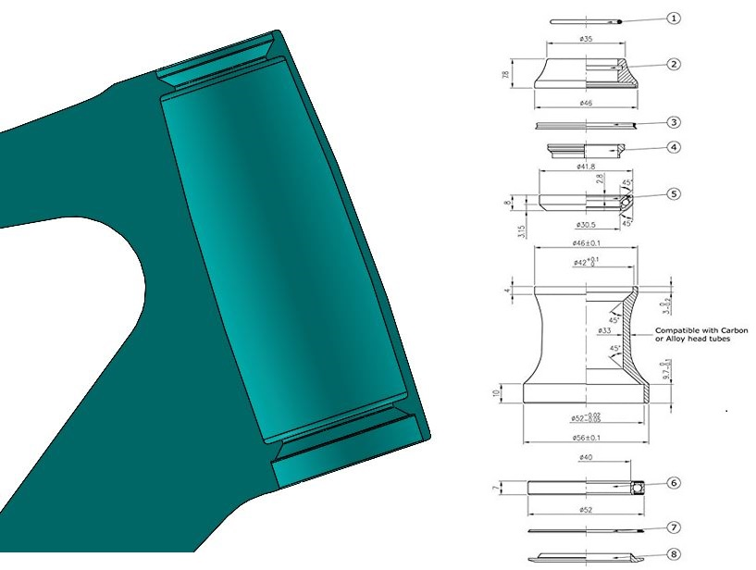
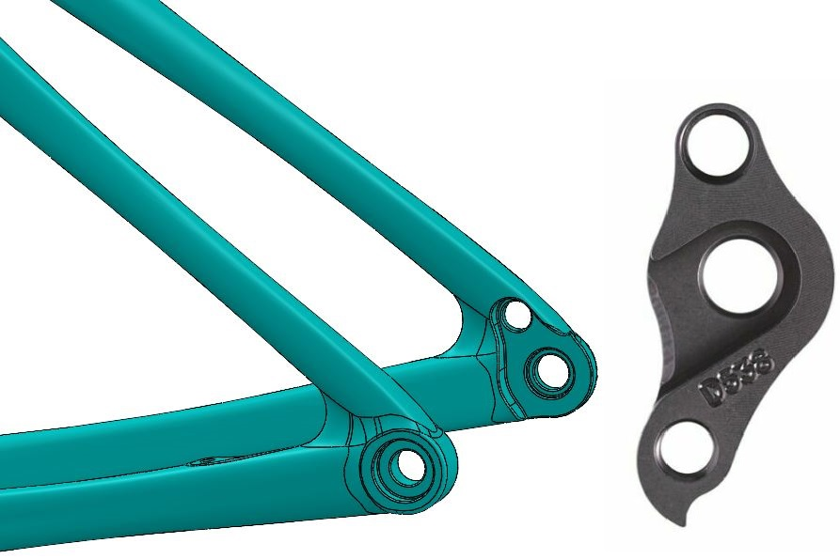
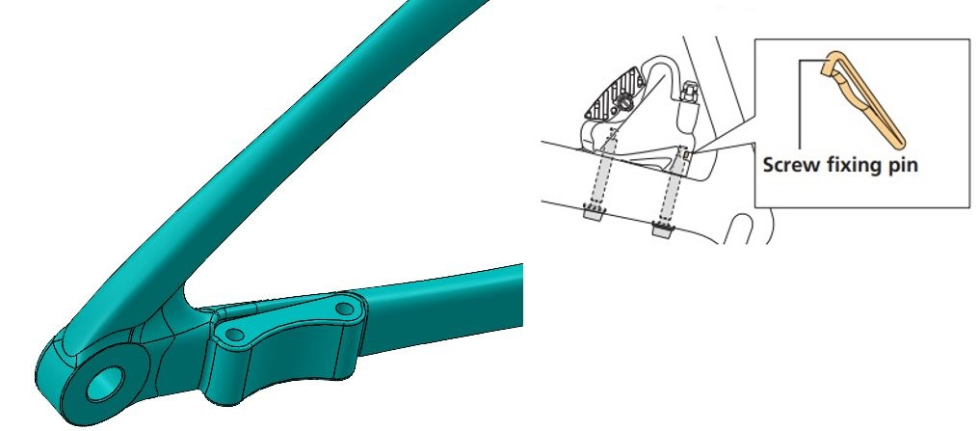
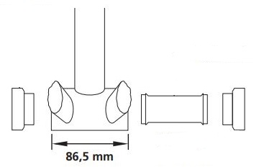
Components
The head-set
The rear dropout
The brake-support
The bottom bracket
Lucrezia Pasi
s288698

Slide 6
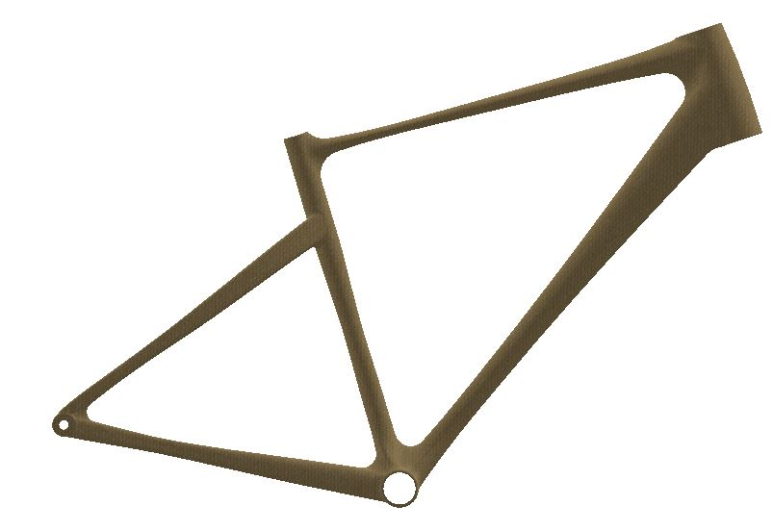
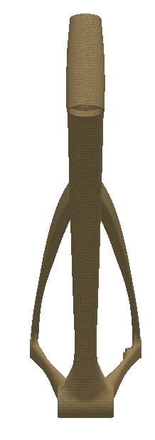
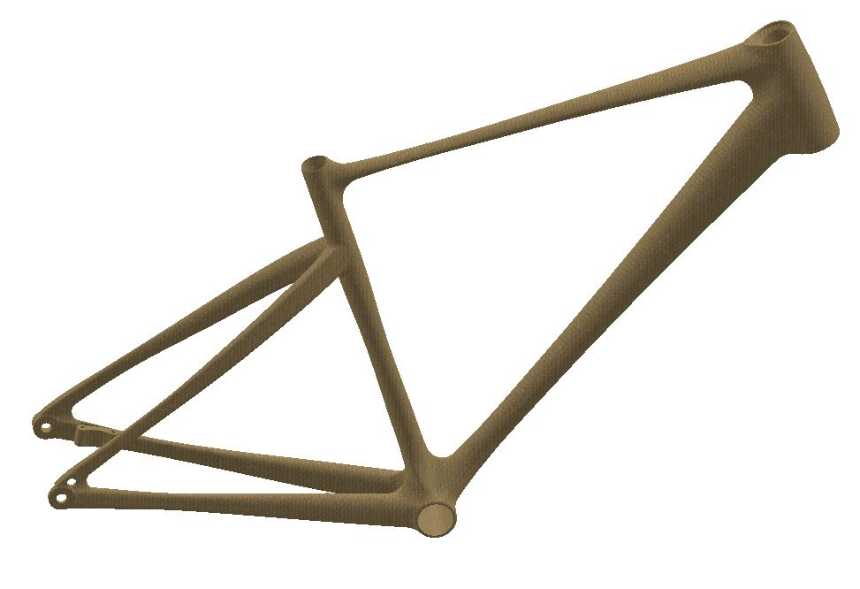
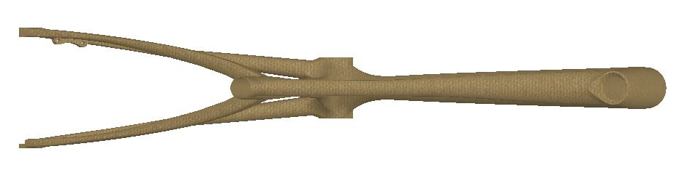
Design result
Lucrezia Pasi
s288698

Slide 7
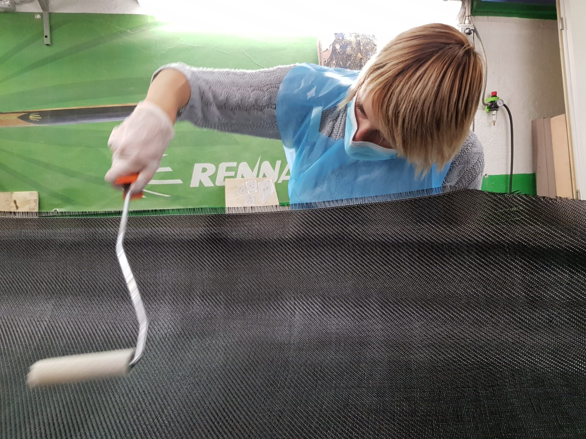
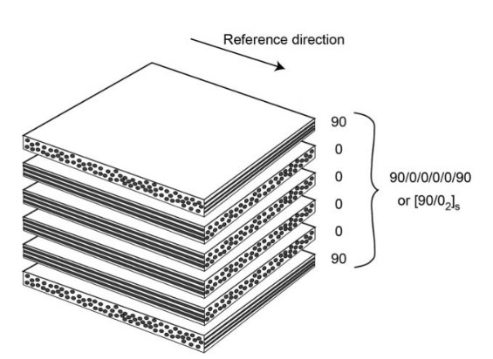
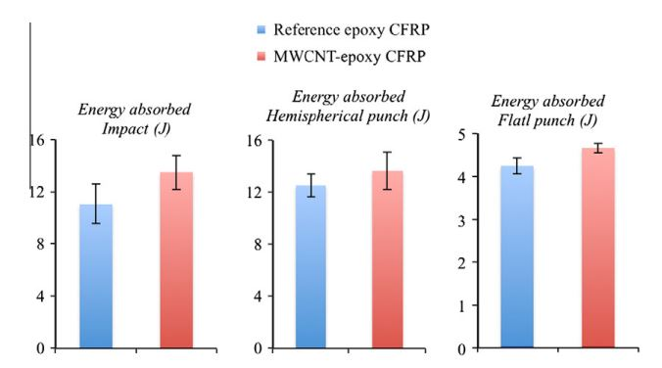
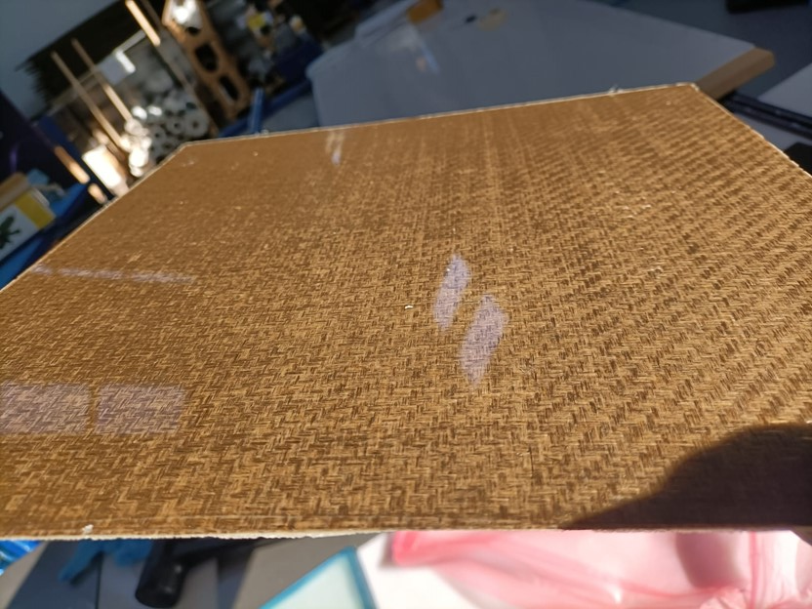
Materials and innovation
Composite materials
Carbon fiber reinforced composites → Nanotube additivated
Natural fiber reinforced composites → hemp
Lucrezia Pasi
s288698

Slide 8
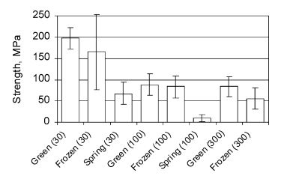
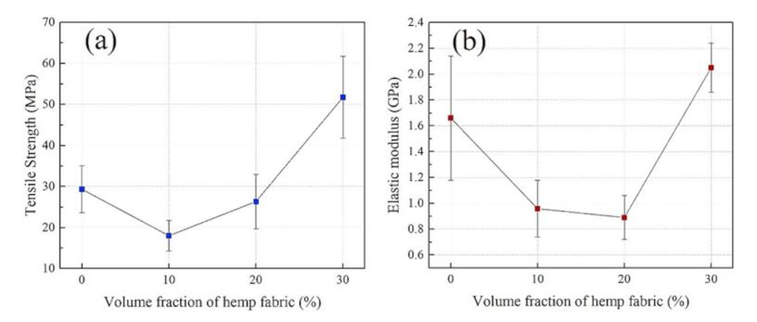
Hemp fiber
One of the strongest and stiffest in between natural fibers
Properties strongly depend on the harvesting and cultivation method
→ Increasing therefore hemp fibers content to 20-30 vol% can improve energy absorption amount
Lucrezia Pasi
s288698

Slide 9
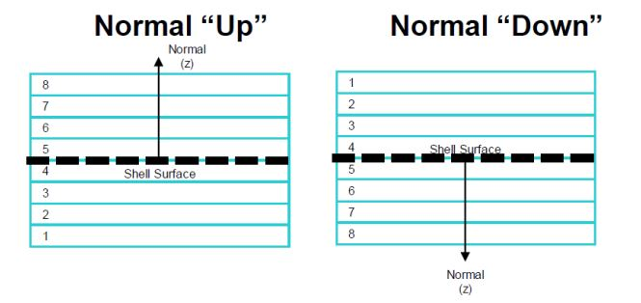
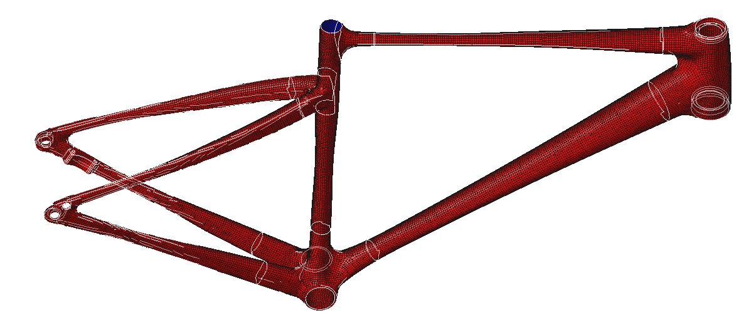
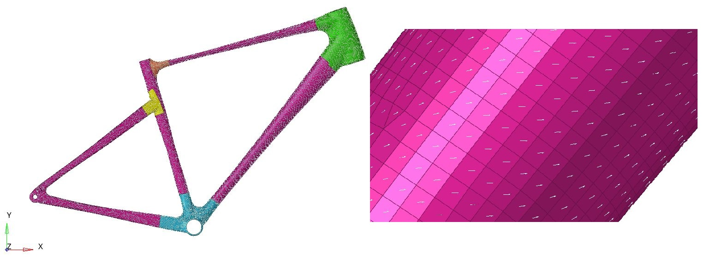
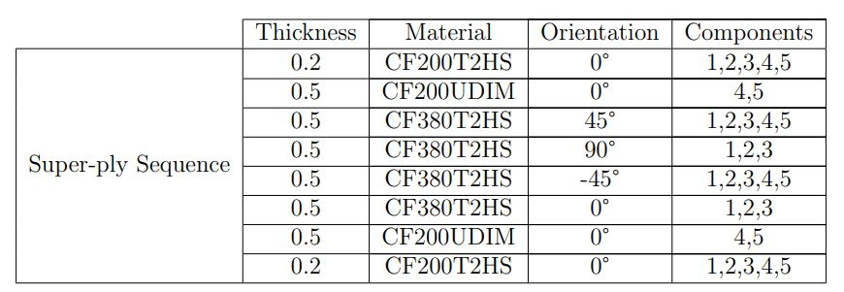
Setting the material on Hypermesh
Check element’s normal
Set element’s orientation
Create laminate (at first, super-plies)
Lucrezia Pasi
s288698

Slide 10
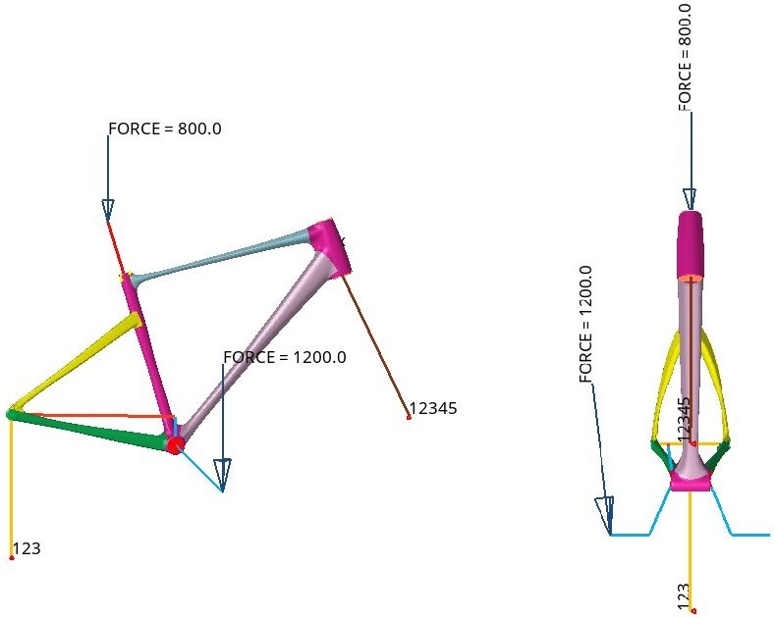
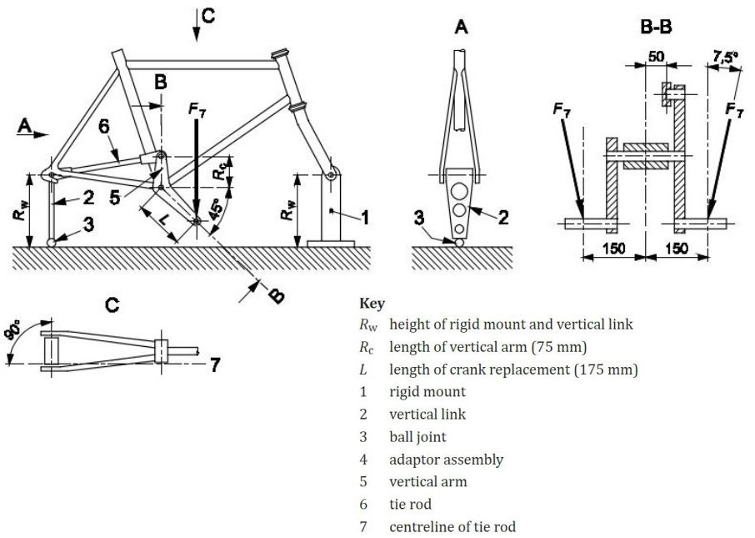
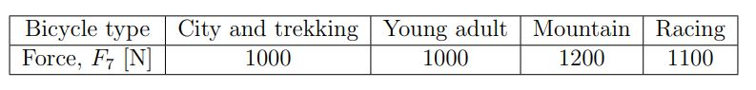
Building a model from standards – pedaling fatigue
Lucrezia Pasi
s288698

Slide 11
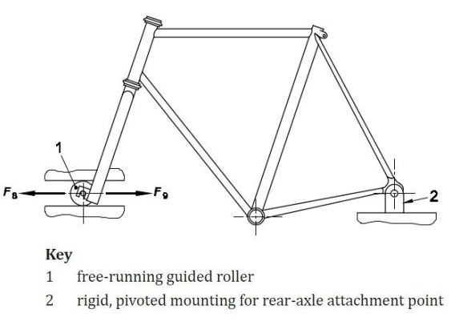
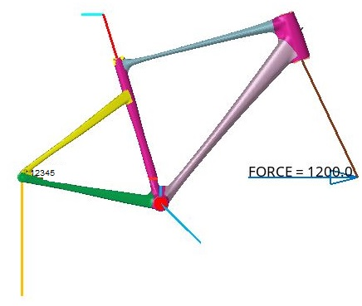
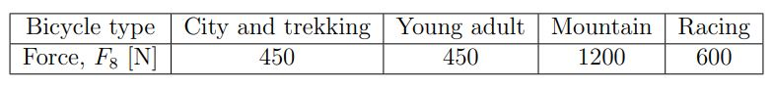
Building a model from standards – horizontal fatigue
Lucrezia Pasi
s288698

Slide 12
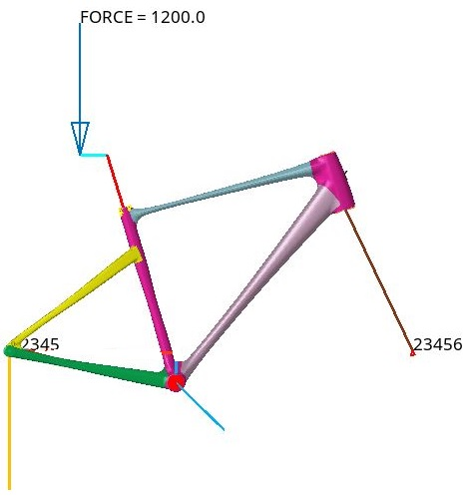
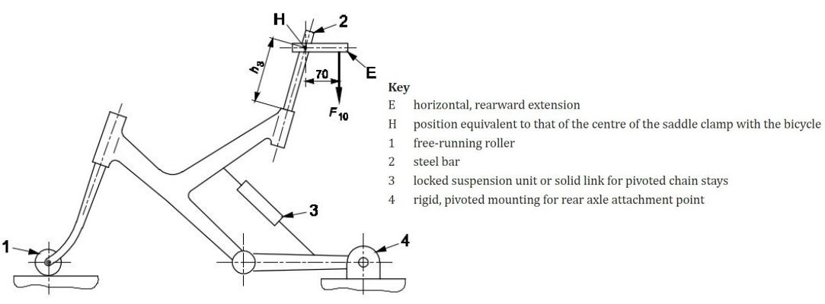
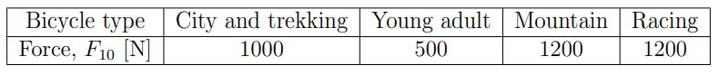
Building a model from standards – vertical fatigue
Lucrezia Pasi
s288698

Slide 13
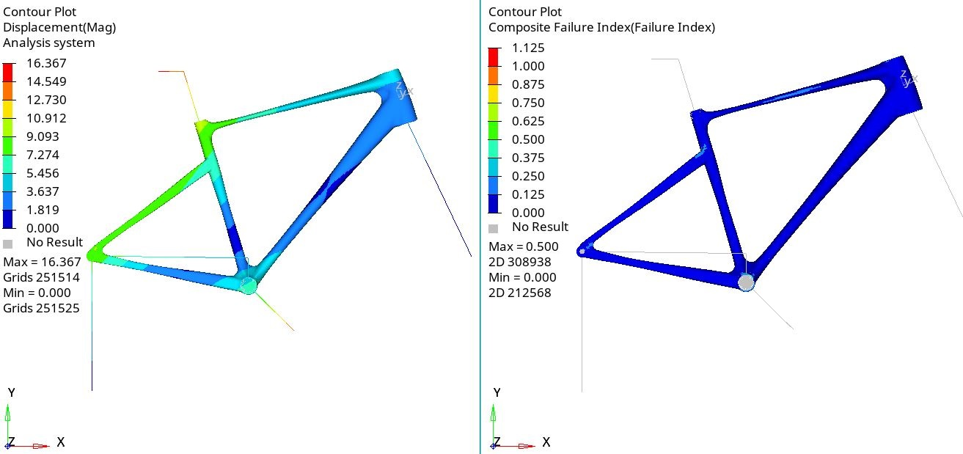
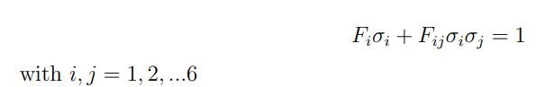
Structural analysis
FAILURE THEORY based on Tsai – Wu failure criteria
Lucrezia Pasi
s288698

Slide 14
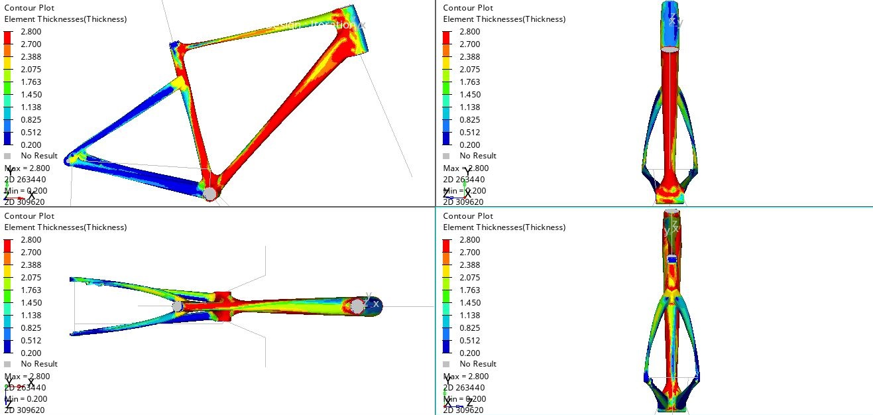
Optimization on Hypermesh – free-size
Lucrezia Pasi
s288698

Slide 15
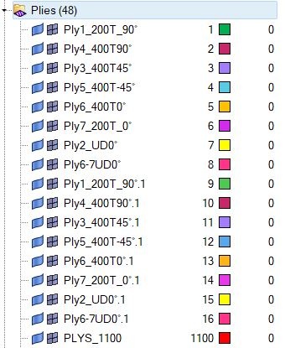
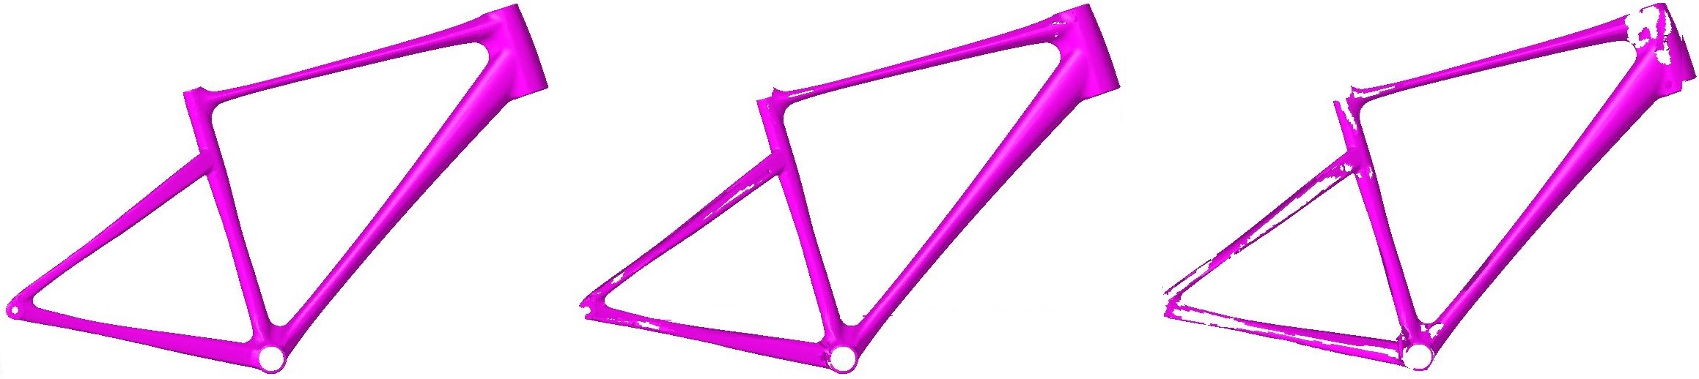
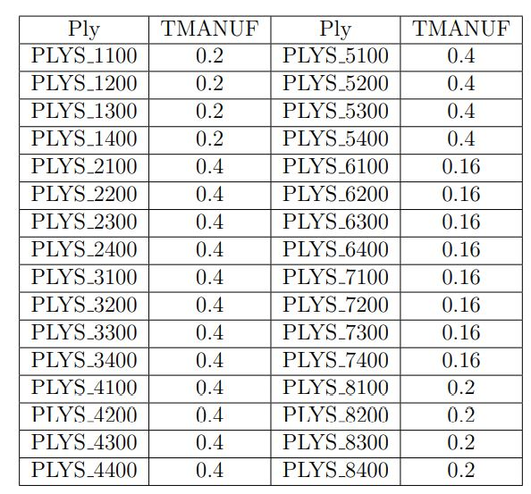
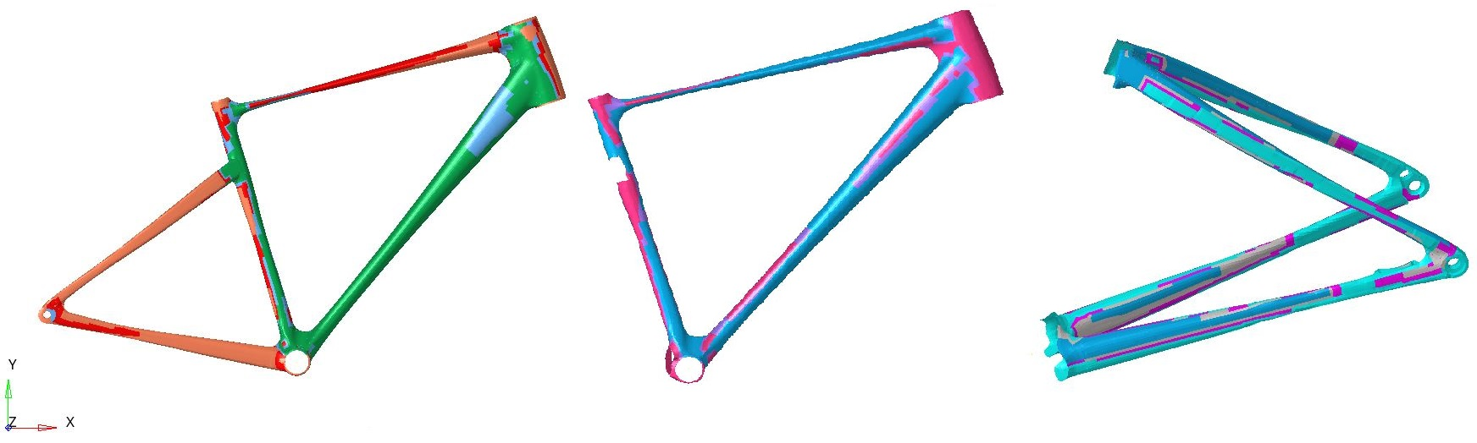
Optimization on Hypermesh – to-size
Lucrezia Pasi
s288698

Slide 16
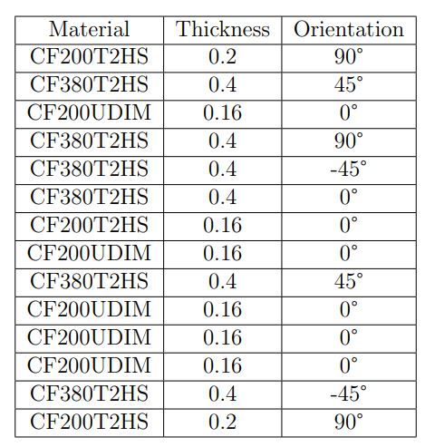
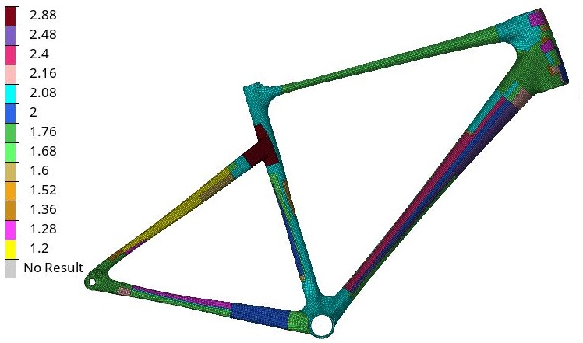
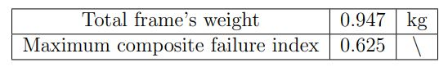
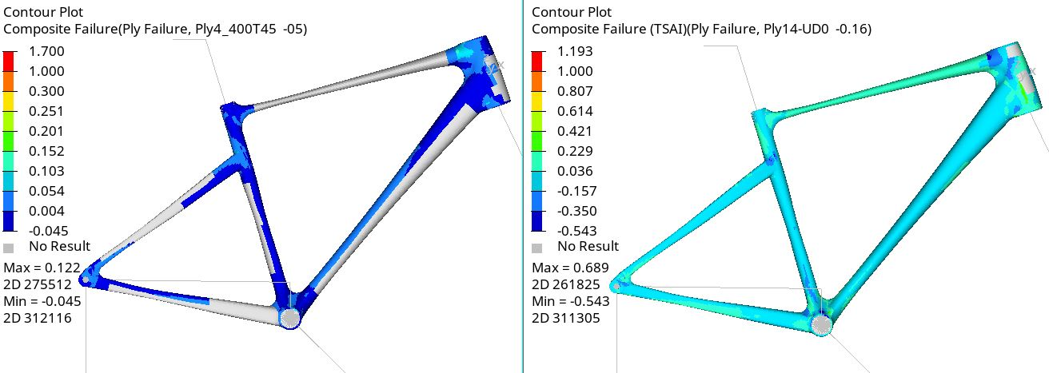
Thicknesses results – carbon fiber
Lucrezia Pasi
s288698

Slide 17
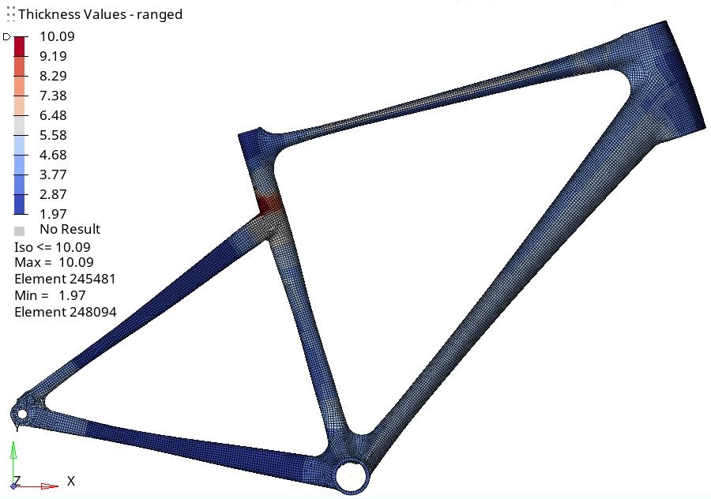
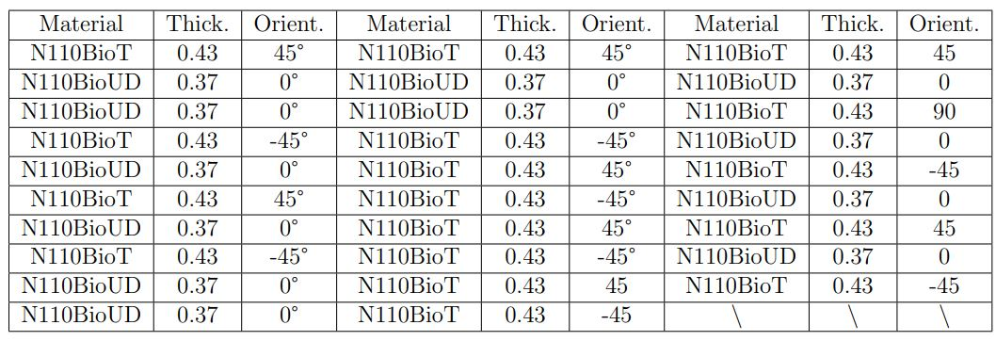
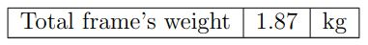
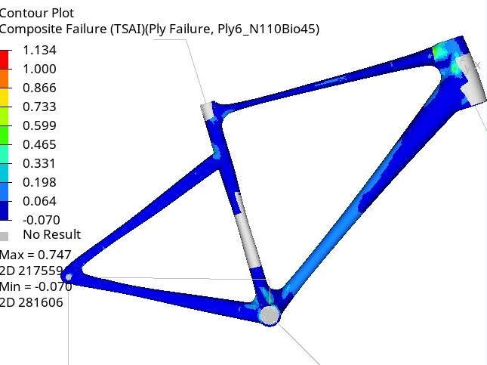
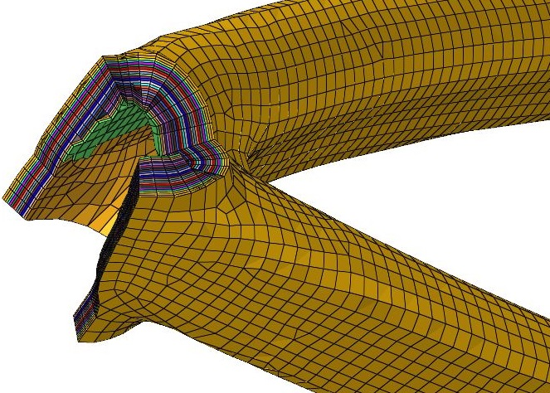
Thicknesses results – hemp fiber
Lucrezia Pasi
s288698

Slide 18
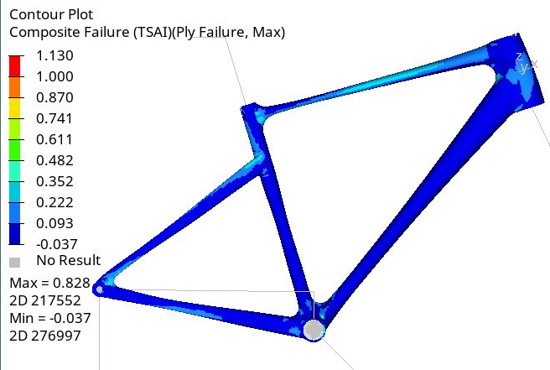
Frame’s comparison and conclusions
Lucrezia Pasi
s288698

